Slide 1
Personal Project - Gymcross
Pablo Rubio Asensi
David Sanchís Morales

Slide 2
Our Project
Our objevtive was to create an app to help people looking for new gym’s.
Users will see a list of possible gyms. When one is clicked the app should
show more information, like the distance from the user to the gym.
Also we want to include a notification system, wich users can use to create custom reminders.

Slide 3
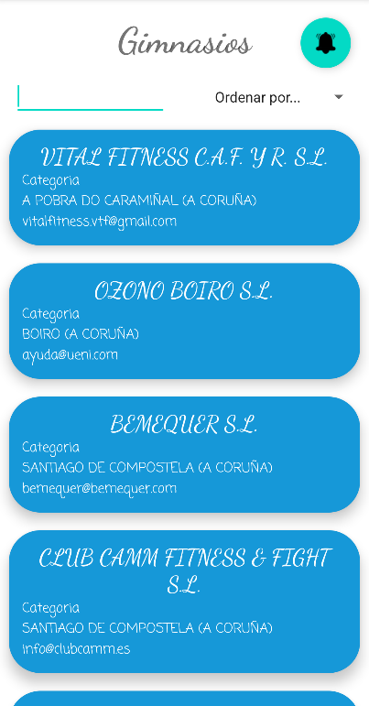
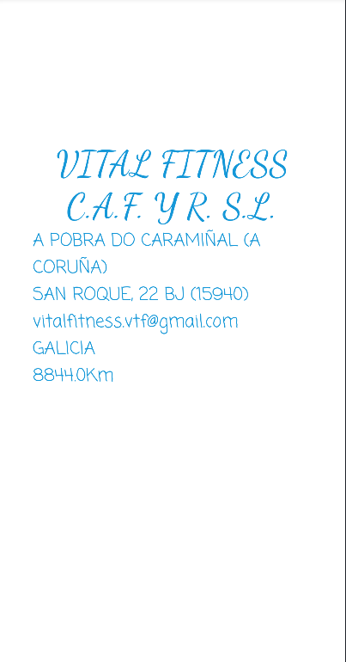
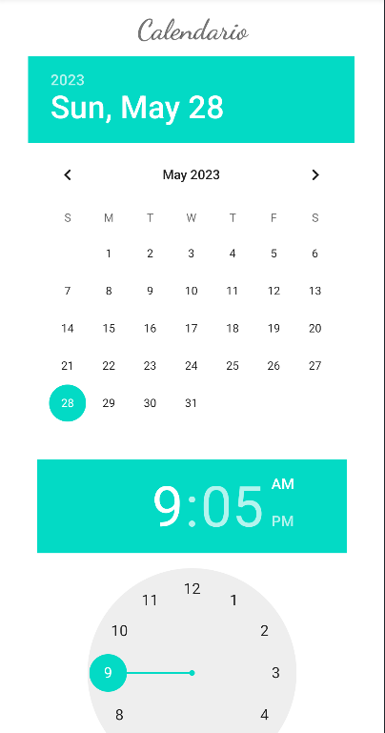
Our Project

Slide 4





selected functionalities
Multiple activities
Splash screen
Local database
Notifications
Location (distance to gym)

Slide 5
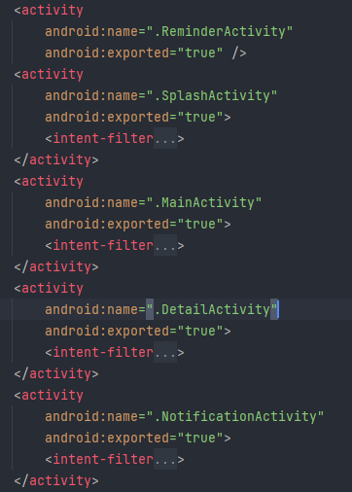
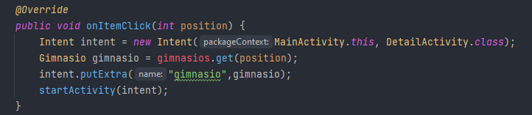
IMPLEMENTATION
Multiple activities

Slide 6
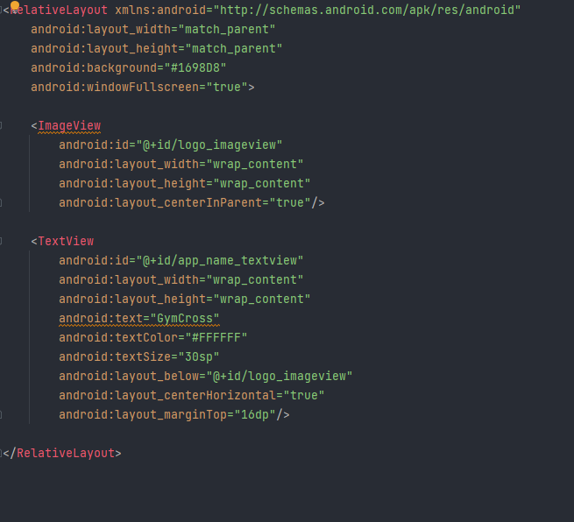
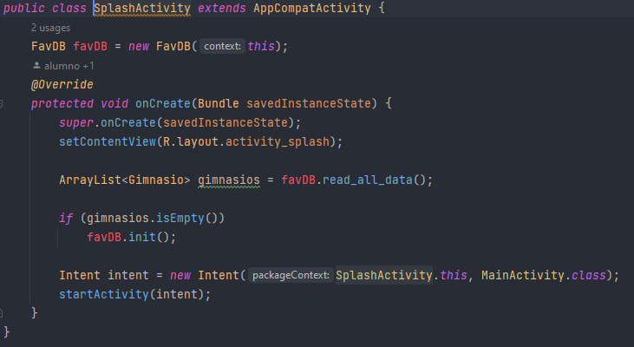
IMPLEMENTATION
Splash screen

Slide 7
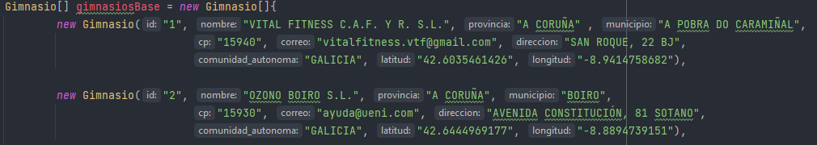
IMPLEMENTATION
Local database (datatypes)

Slide 8
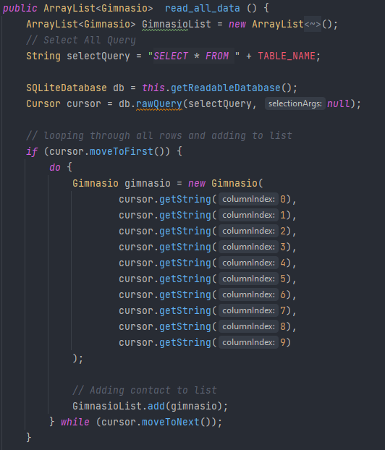
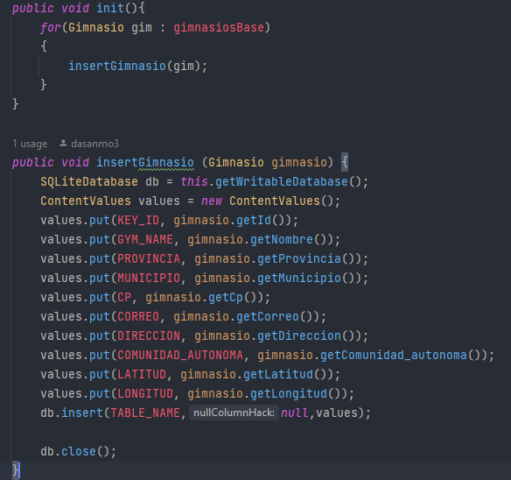
IMPLEMENTATION
Local database (interaction)

Slide 9
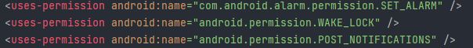
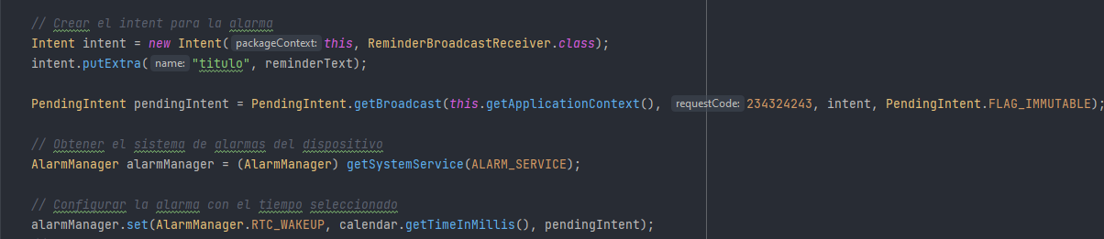
IMPLEMENTATION
Notifications

Slide 10
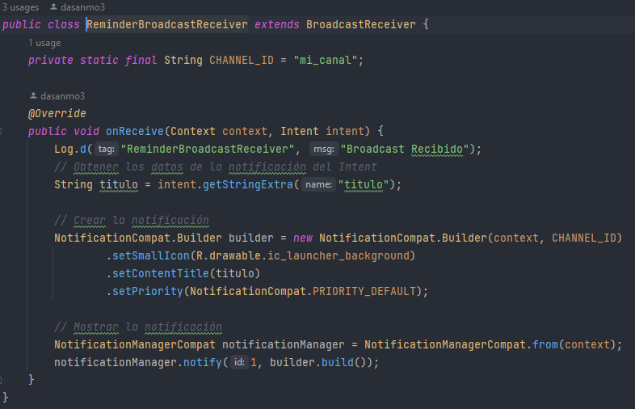
IMPLEMENTATION
Notifications

Slide 11
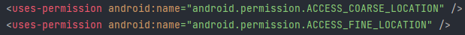
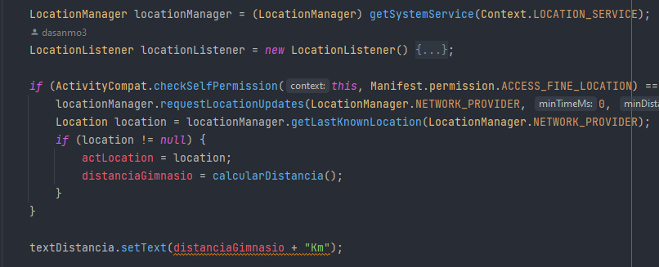
IMPLEMENTATION
Location (distance to gym)

Slide 12
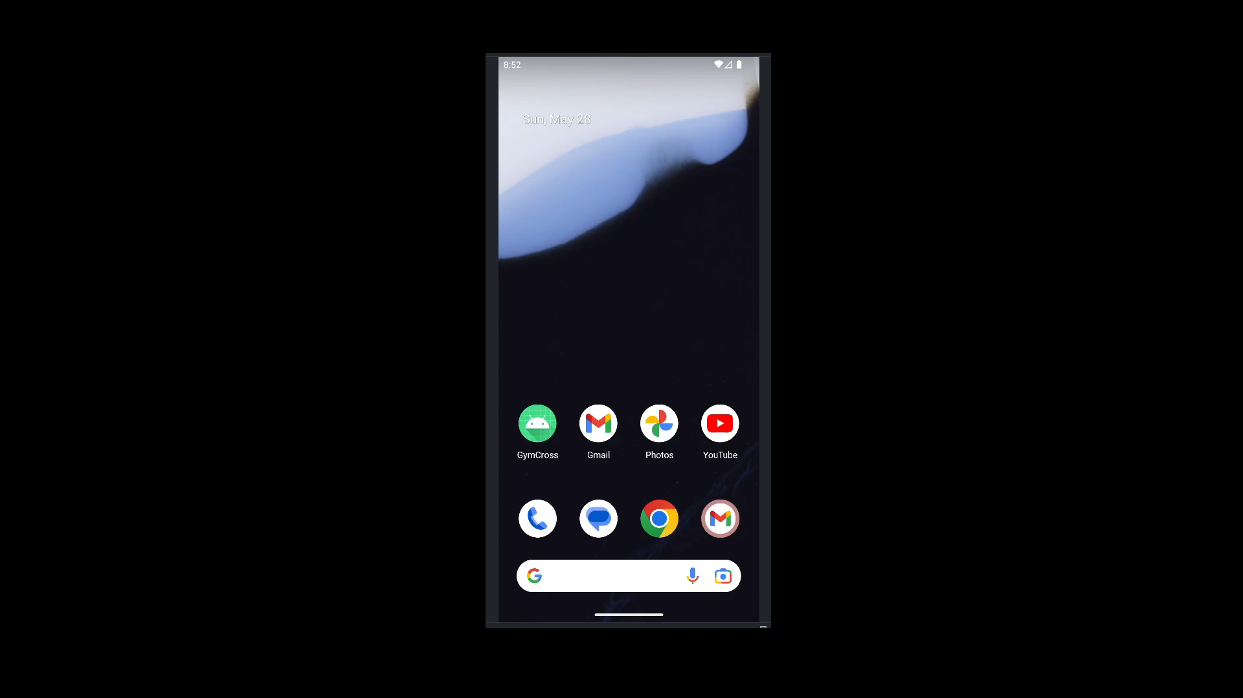
Video

